Slide 1
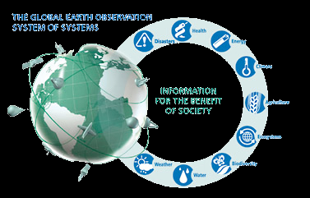
The Next Revolution for the GEOSS Common Infrastructure (GCI)
4th GEOSS Science and Technology Stakeholder Workshop CONCEPTS, TECHNOLOGIES, SYSTEMS AND USERS OF THE NEXT GEOSS March 24-26, 2015, Norfolk, VA, USA
Stefano Nativi
National Research Council of Italy (CNR-IIA)

Slide 2
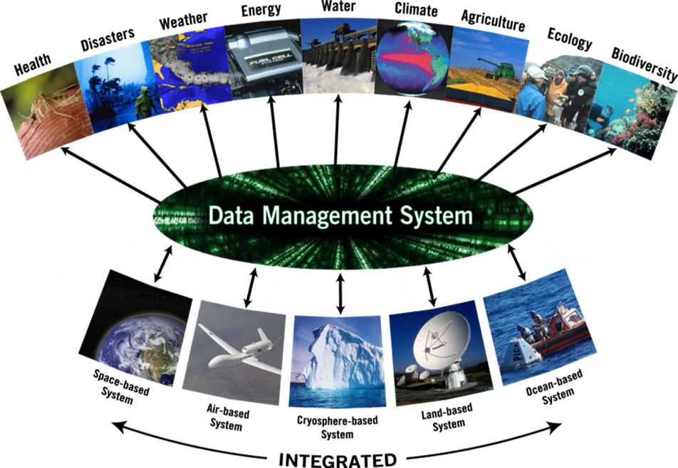
Global Earth Observation Systems of Systems (GEOSS)
Science & Society
GEOSS Common Infrastructure (GCI)
Data & Information Providers

Slide 3
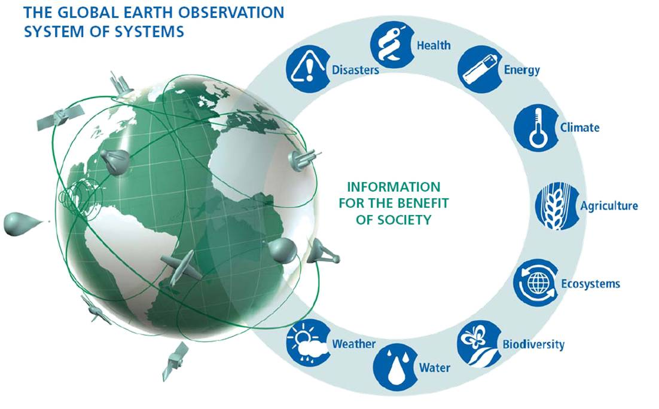
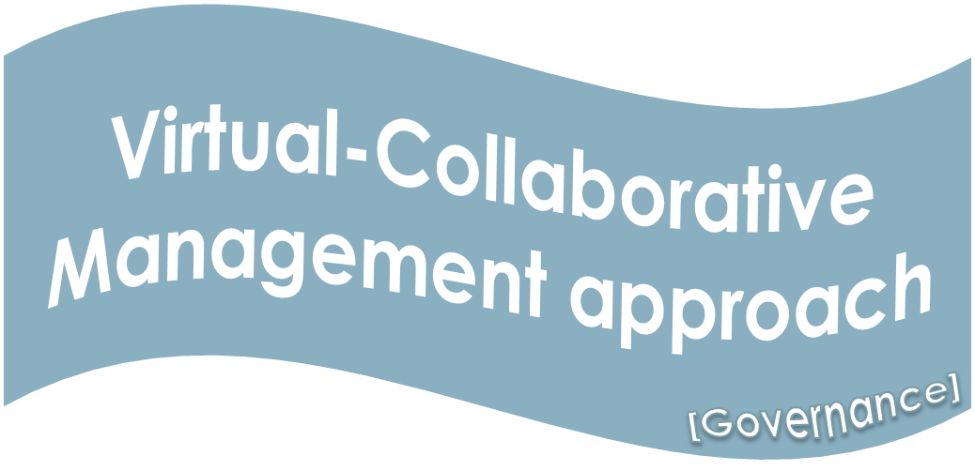
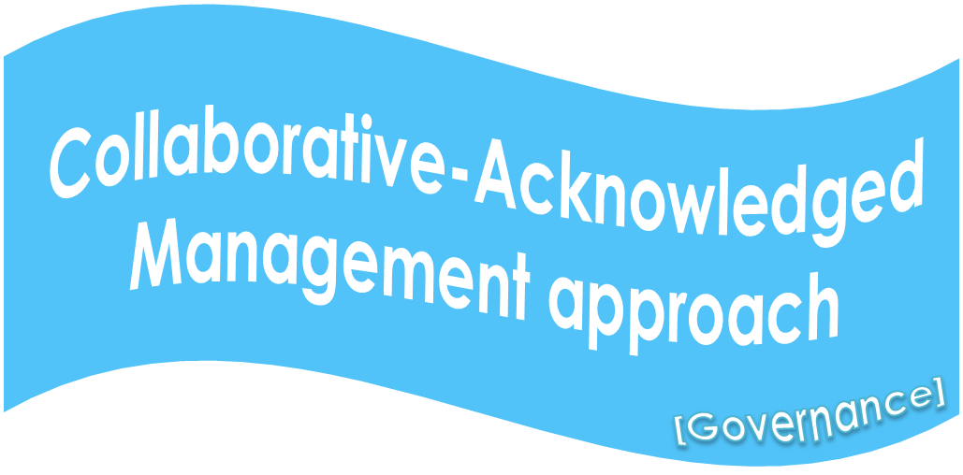
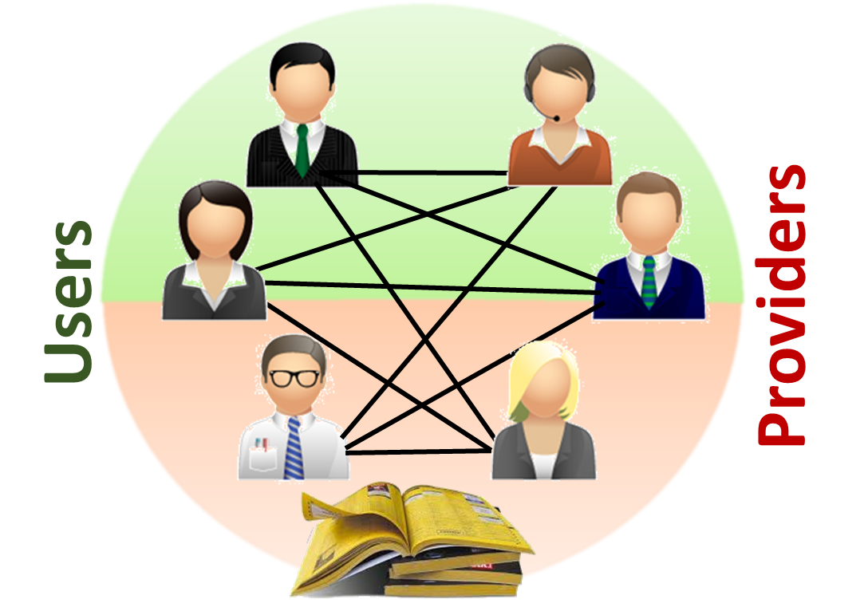
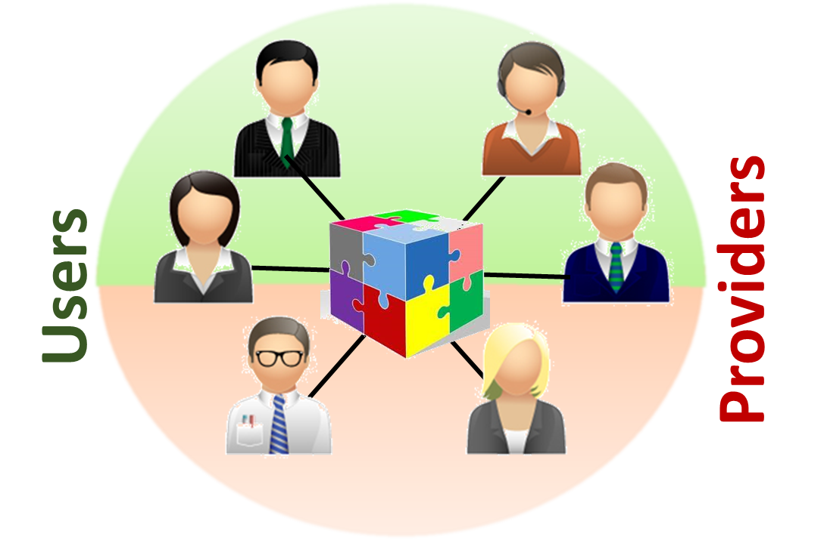
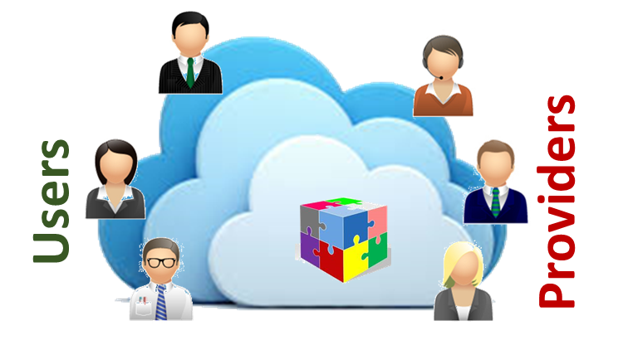
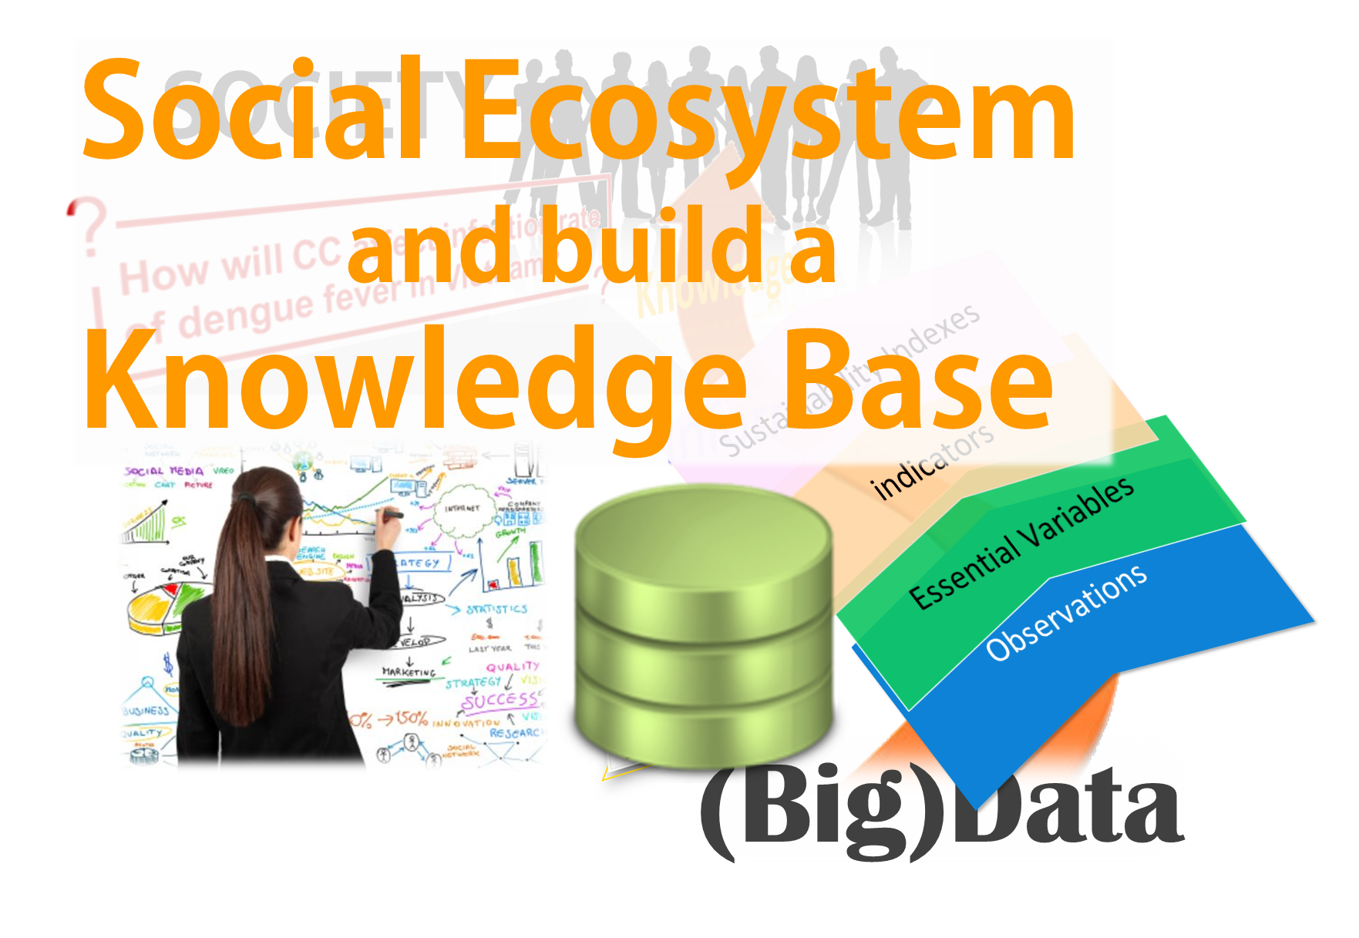
The GCI revolutions
2005
2011
2013
2016
1st Revolution
2nd Revolution
[Service driven]
Catalog of catalogs
3rd Revolution
[Brokering pattern]
Brokering framework
4th Revolution
[Big Data]
Cloud-based EcoSystem
[… .]
… .
Discovery
Discovery and Access
[functionality]
(re-)Use
[functionality]
[functionality]

Slide 4
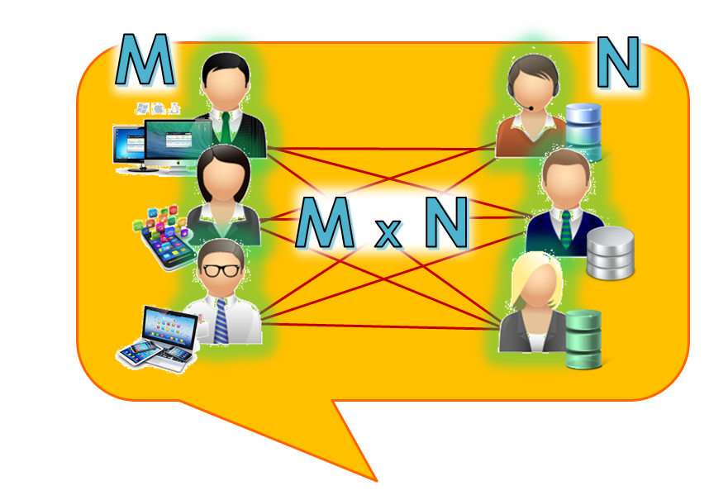
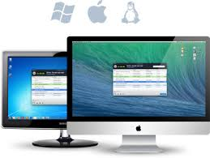
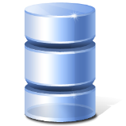
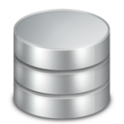
Virtual Community Approach
Service Providers
Service Users
Data Applications
Data Infrastructures
Virtual-Collaborative Management approach
Registry
[Governance]

Slide 5
Recognized Barriers (important for GEOSS)
Problem: service users need to know the nature and location of service providers,
making it difficult to bind and dynamically change the bindings between users and providers
Solution: The broker pattern separates users of services (clients) from providers of services (servers) by inserting an intermediary, called a broker.
When a client needs a service, it queries a broker via a service interface. The broker then forwards the client’s service request to a server, which processes the request

Slide 6
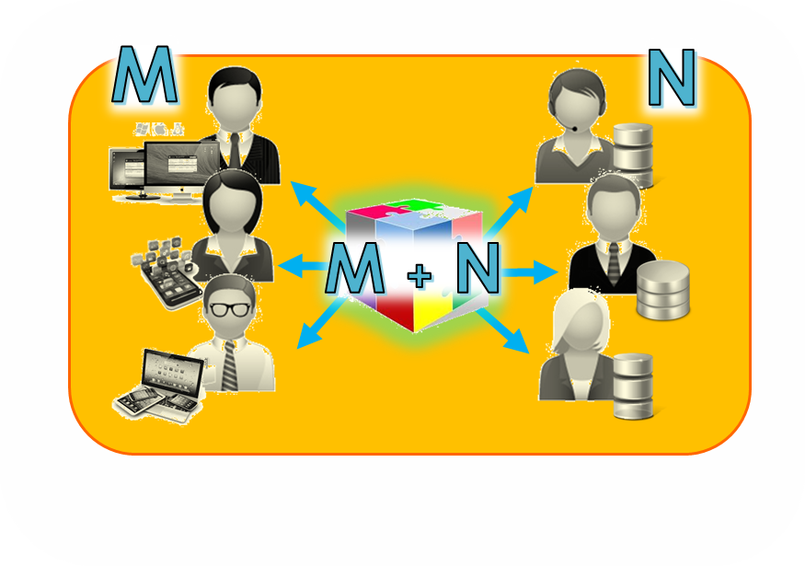
GEOSS supplementing Role
Service Providers
Service Users
Mediation
Mediation
Data Applications
Data Infrastructures
Mediation
Mediation
Collaborative-Acknowledged Management approach
Mediation
Mediation
[Governance]

Slide 7
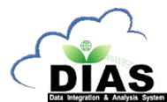
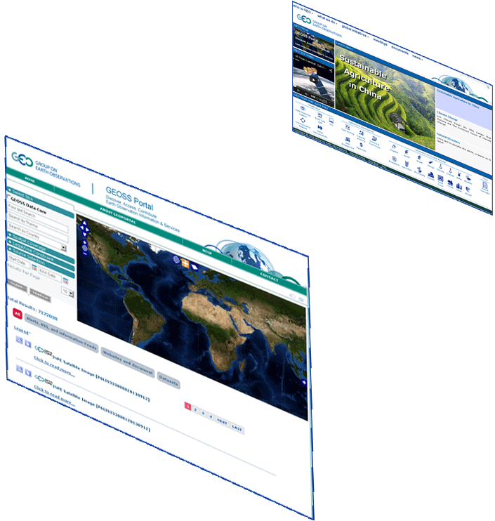
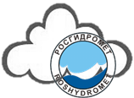
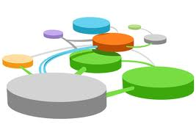
GEOSS Information System
GEO Home Page
GEOSS Portal
More than 35
brokered systems
Systems
Registry
Semantic engines
.. .
.. .
Data Providers Brokered (capacities, systems, networks, etc.)
Private sector(tested interoperability)
Notes:
Added GEOSS Clearinghouse, IDN, and CWIC, moved NOAA, added JAXA

Slide 8
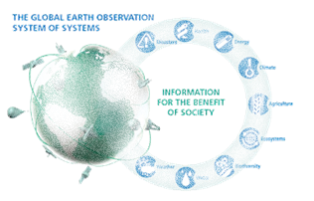
Big Data challenges for GEOSS
Scalability
and
Reliability
Volume: Millions of discoverable (small & medium) products; Long EO time/space series, … .
Variety: Different product types (data, services, models, documents); Data models; Protocols; Semantics; Granularity levels; Organizations; Maturity level, … .
Veracity/Validity/Value: Evaluation support, Essential Variables, Discovery Ranking, User Feedbacks, … .
Velocity: serve Countries with limited Internet access, Fast Discovery & Access, Data Transformation and Analytics
Visualization: Preview, Tiling services, visual exploration, … .

Slide 9
GEOSS Information System
GEO Home Page
Less data, more INFO
Flexible Configurations
GEOSS Portal
Brokering approach
Cloud Revolution
.. .
NoSQL databases
.. .
Data Providers Brokered (capacities, systems, networks, etc.)
Private sector(tested interoperability)
Notes:
Added GEOSS Clearinghouse, IDN, and CWIC, moved NOAA, added JAXA

Slide 10
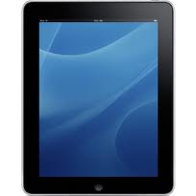
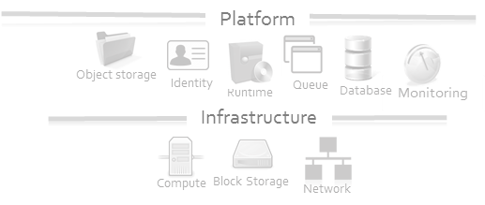
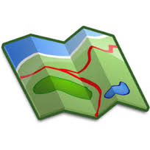
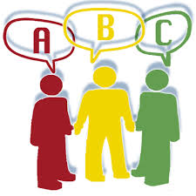
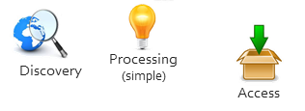
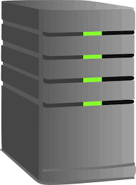
Web Browser
Mobile App
Mobile App
GEO Home Page
GEOSS Community Portals
GEOSS Portal
Hybrid Cloud services
(integrating public and private clouds)
DAB APIs
(Cloud-based)
Software Ecosystem
Discovery
Evaluation
Processing
(simple)
Visualization
Access
Mobile App
Collaborative-Acknowledged Management approach
Brokering
Tagging
Workflow mangmt
QoS control
Tiling
Monitoring
Data Server
Platform
Data Server
GCI 2.0
Infrastructure
[Governance]
… .
Existing e-Infrastructure Services
Existing e-Infrastructure Services

Slide 11
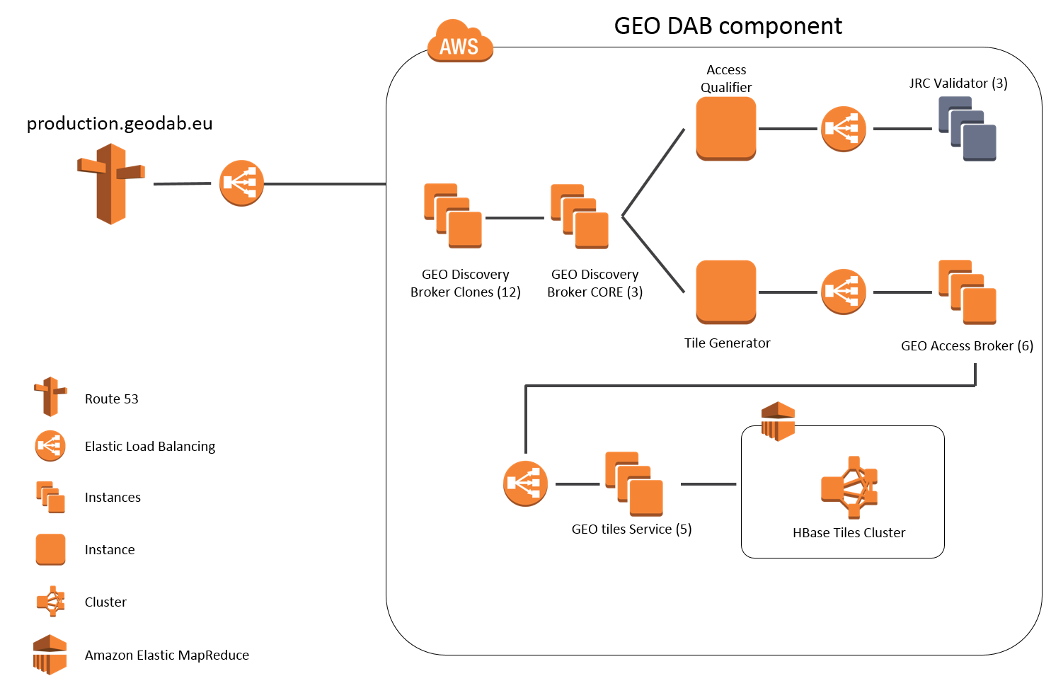
(GCI 2.0) GEO DAB in the Cloud
Scalable and reliable services
(e.g. more than 32 virtual machines on a public cloud)
15 GEO Discovery Broker nodes
6 GEO Access Broker nodes
3 Data Provider Service Validator nodes
4 Elastic Load Balancing nodes
5 GEO Tiles nodes
1 Hbase Tiles (elastic) Cluster

Slide 12
The Next Revolution
Extending the GEOSS Software and Social Ecosystem
GCI 3.0
Fourth Revolution

Slide 13
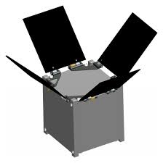
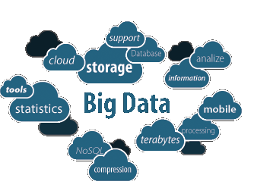
CROWDSOURCING
PICO SATELLITES
SMART CITIES
CLOUD COMP.
ANALYTICS
CONSUMERIZATION
CITIZEN OBSERVATORIES

Slide 14
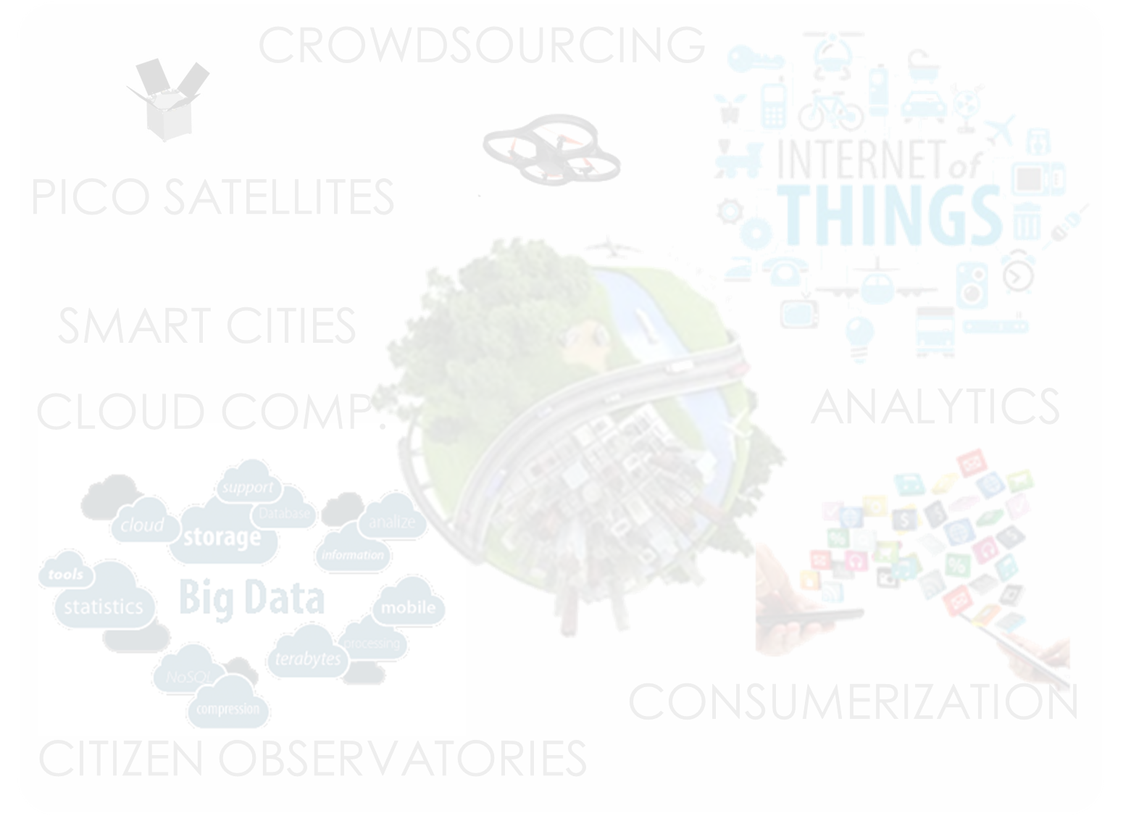
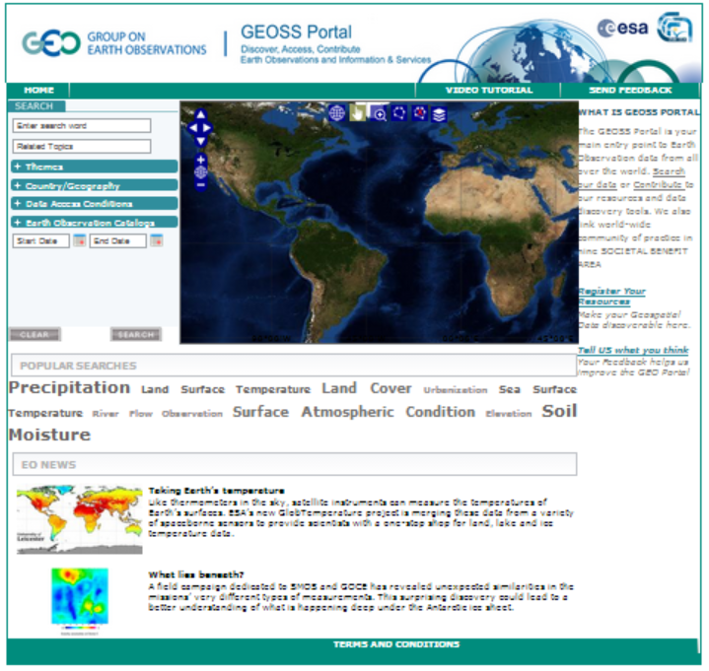
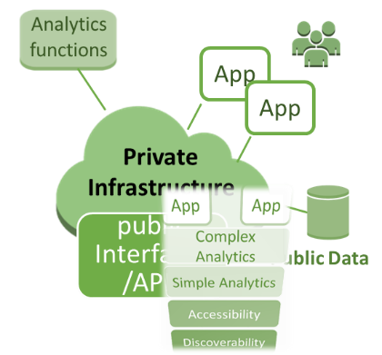
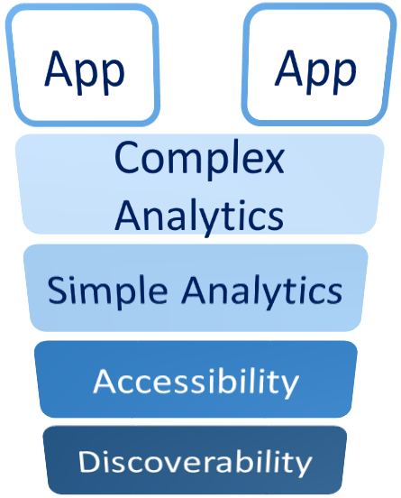
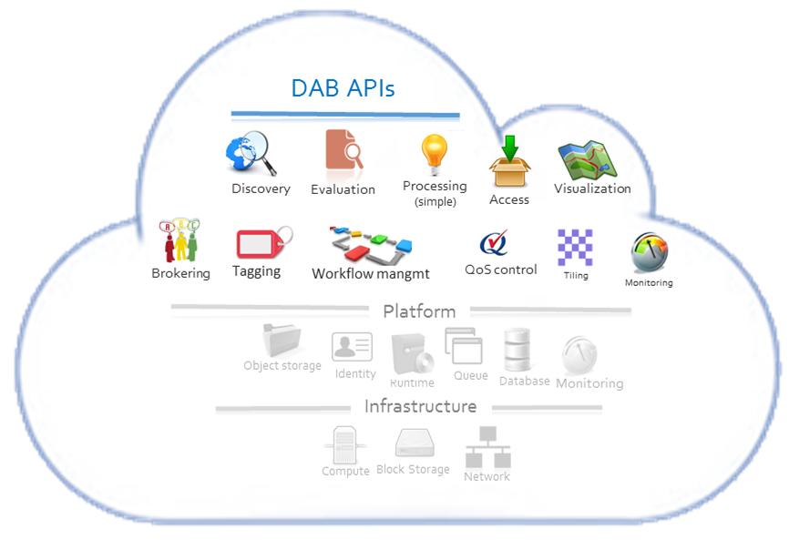
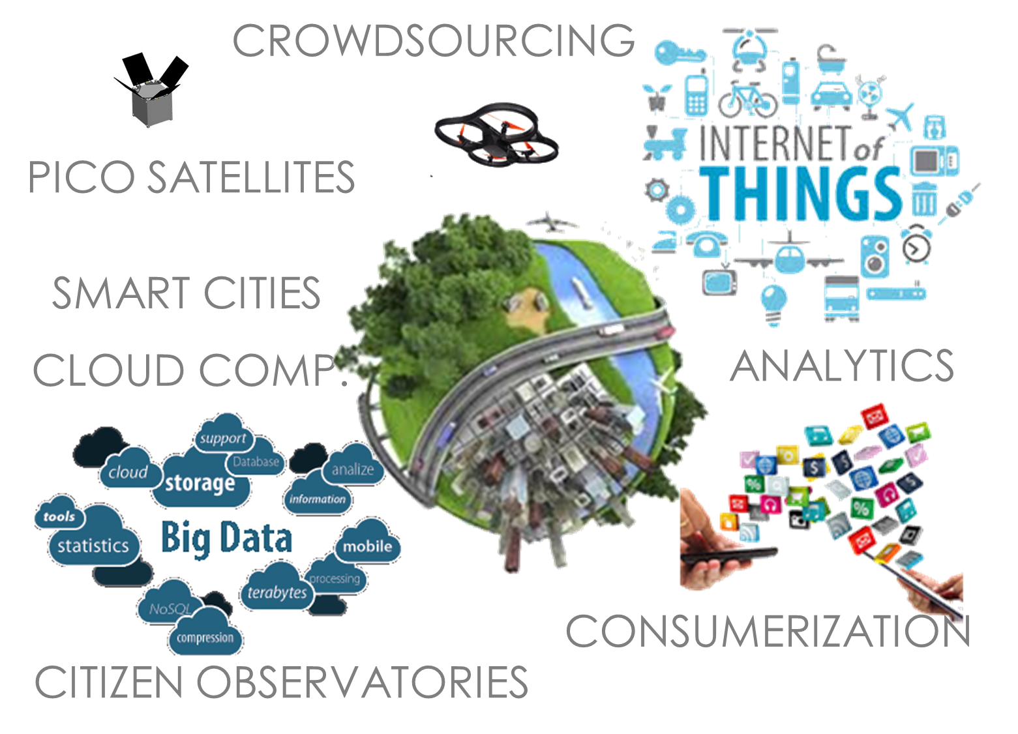
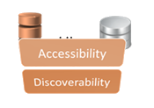
Private Company Systems
Community
Portals
GEOSS
Portal
… .
Software Ecosystem
(Cloud based)
GEOSS Information System
(GCI 3.0)
SoS
Brokering Framework
GEOSS Knowledge Base
Collaborative-Acknowledged Management approach
… .
GEOSS systems
Registry
Public Systems
GEOSS interdisciplinary
Collaboration & Social services
[Governance]
NGO systems

Slide 15
Social Ecosystem
and build a
Knowledge Base
SOCIETY
Sustainability Indexes
indicators
Knowledge
Essential Variables
Information
Observations
(Big)Data

Slide 16
2005 GEOSS Implementation Plan Reference Document
Expert Knowledge
Models
Socio-economic Data
EO Data
Models
KNOWLEDGE
Socio-Economic Data
Earth Observation Data

Slide 17
What if…
Social Science
Socioeconomic
Fossil Fuel Use Model
[Source: Gary Geller, GEO Sec]
Data
Climatology
Global Climate
Model
Regional
Climate Model
Observational Data
(environment &
vector distribution)
Data
Data
Data
Health
Deforestation/
Disturbance Model
Vector Niche
Model
Infection
Rate Model
Biodiversity
Data
Human Population Density
and Distribution Model
Infection Rates
Social Science

Slide 18
Resources…
Data

Slide 19
Resources…
Data
Model

Slide 20
Resources…
Data
Model
Link (Interface)
Knowledge Bases (ontologies)
Semantic services
Brokers

Slide 21
Resources…
Business Process
Data
Model
Link (Interface)

Slide 22
GEO Model Web
A dynamic web of models, integrated with databases and websites, to form a consultative infrastructure where researchers, managers, policy makers, and the general public can go to gain insight into “what if” questions
[Coordinators: Stefano Nativi (CNR) and Gary Geller (GEO sec)]

Slide 23
From Data to
Knowledge
«algorithm»
2015
next decade
2020
BP
«algorithm»
BP
addressedBy
«Wisdom»
What if ...
1..*
0..*
«algorithm»
BP
«algorithm»
BP
Social Ecosystem
1..*
relatedTo
0..*
«Wisdom»
Scientific
Challenge

Slide 24
Conclusions
In 10 years, GEOSS and IIB have done a valuable work recognizing and embracing significant technological revolutions
Discoverability
Accessibility
Flexibility and openness are important to assure its evolution
Next revolution will require to develop
A cloud-based Software Ecosystem
A Social Ecosystem to create and share a Knowledge Base

Slide 25
Thank you !
Questions?

